Slide 1
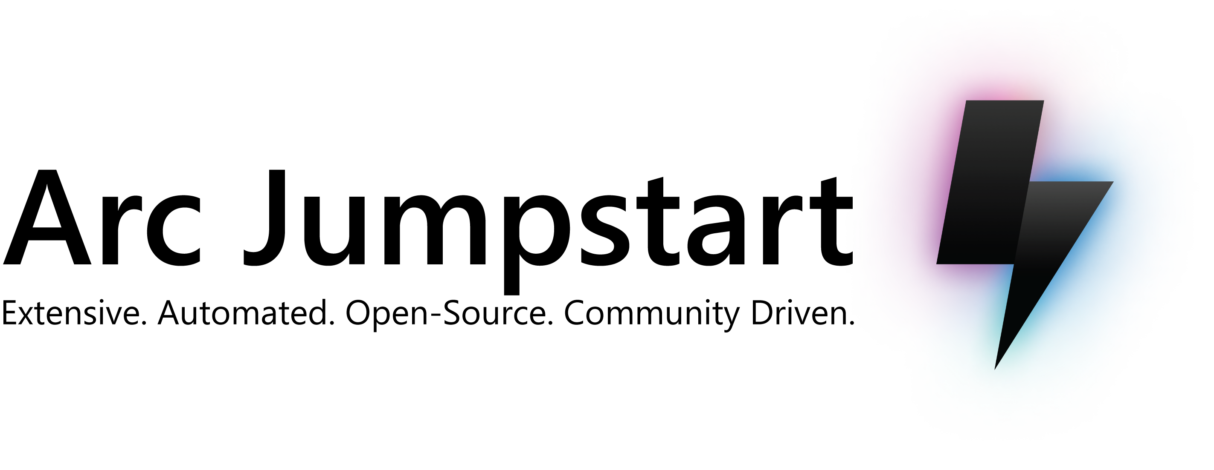
aka.ms/ArcJumpstart

Slide 2







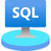
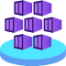
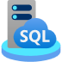

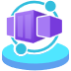









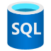




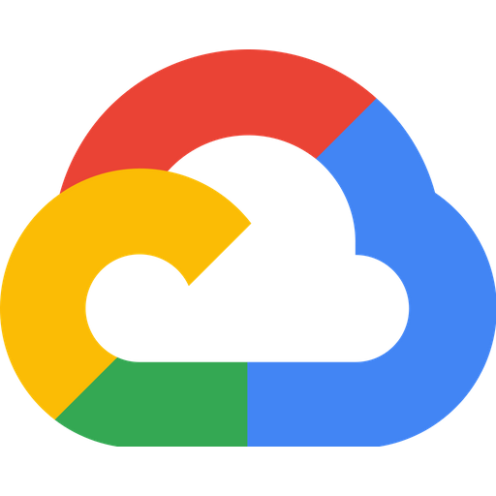
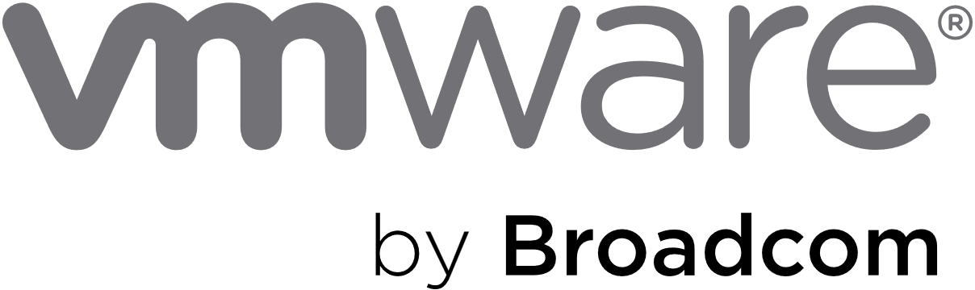


Azure Arc solution overview architecture
Unified operations, management, compliance, security, and governance
Arc-enabled servers, Arc VMs, SQL Server, and Kubernetes resources
Arc-enabled services resources
(data, app, and ML services)
Arc-enabled industrial assets resources
Azure Resource Manager (ARM)
Azure control plane span across cloud and edge via Azure Arc
Multi cloud
On-premises
Operational edge
Servers, SQL, and Kubernetes
Arc-enabled services
Servers, SQL, and Kubernetes
Arc-enabled services
Servers and Kubernetes
Industrial assets
Azure IoT Operations enabled by Arc
Azure Local
System Center Virtual Machine Manager

Slide 3
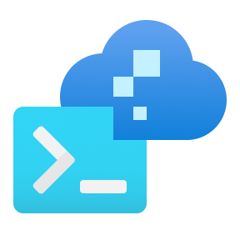










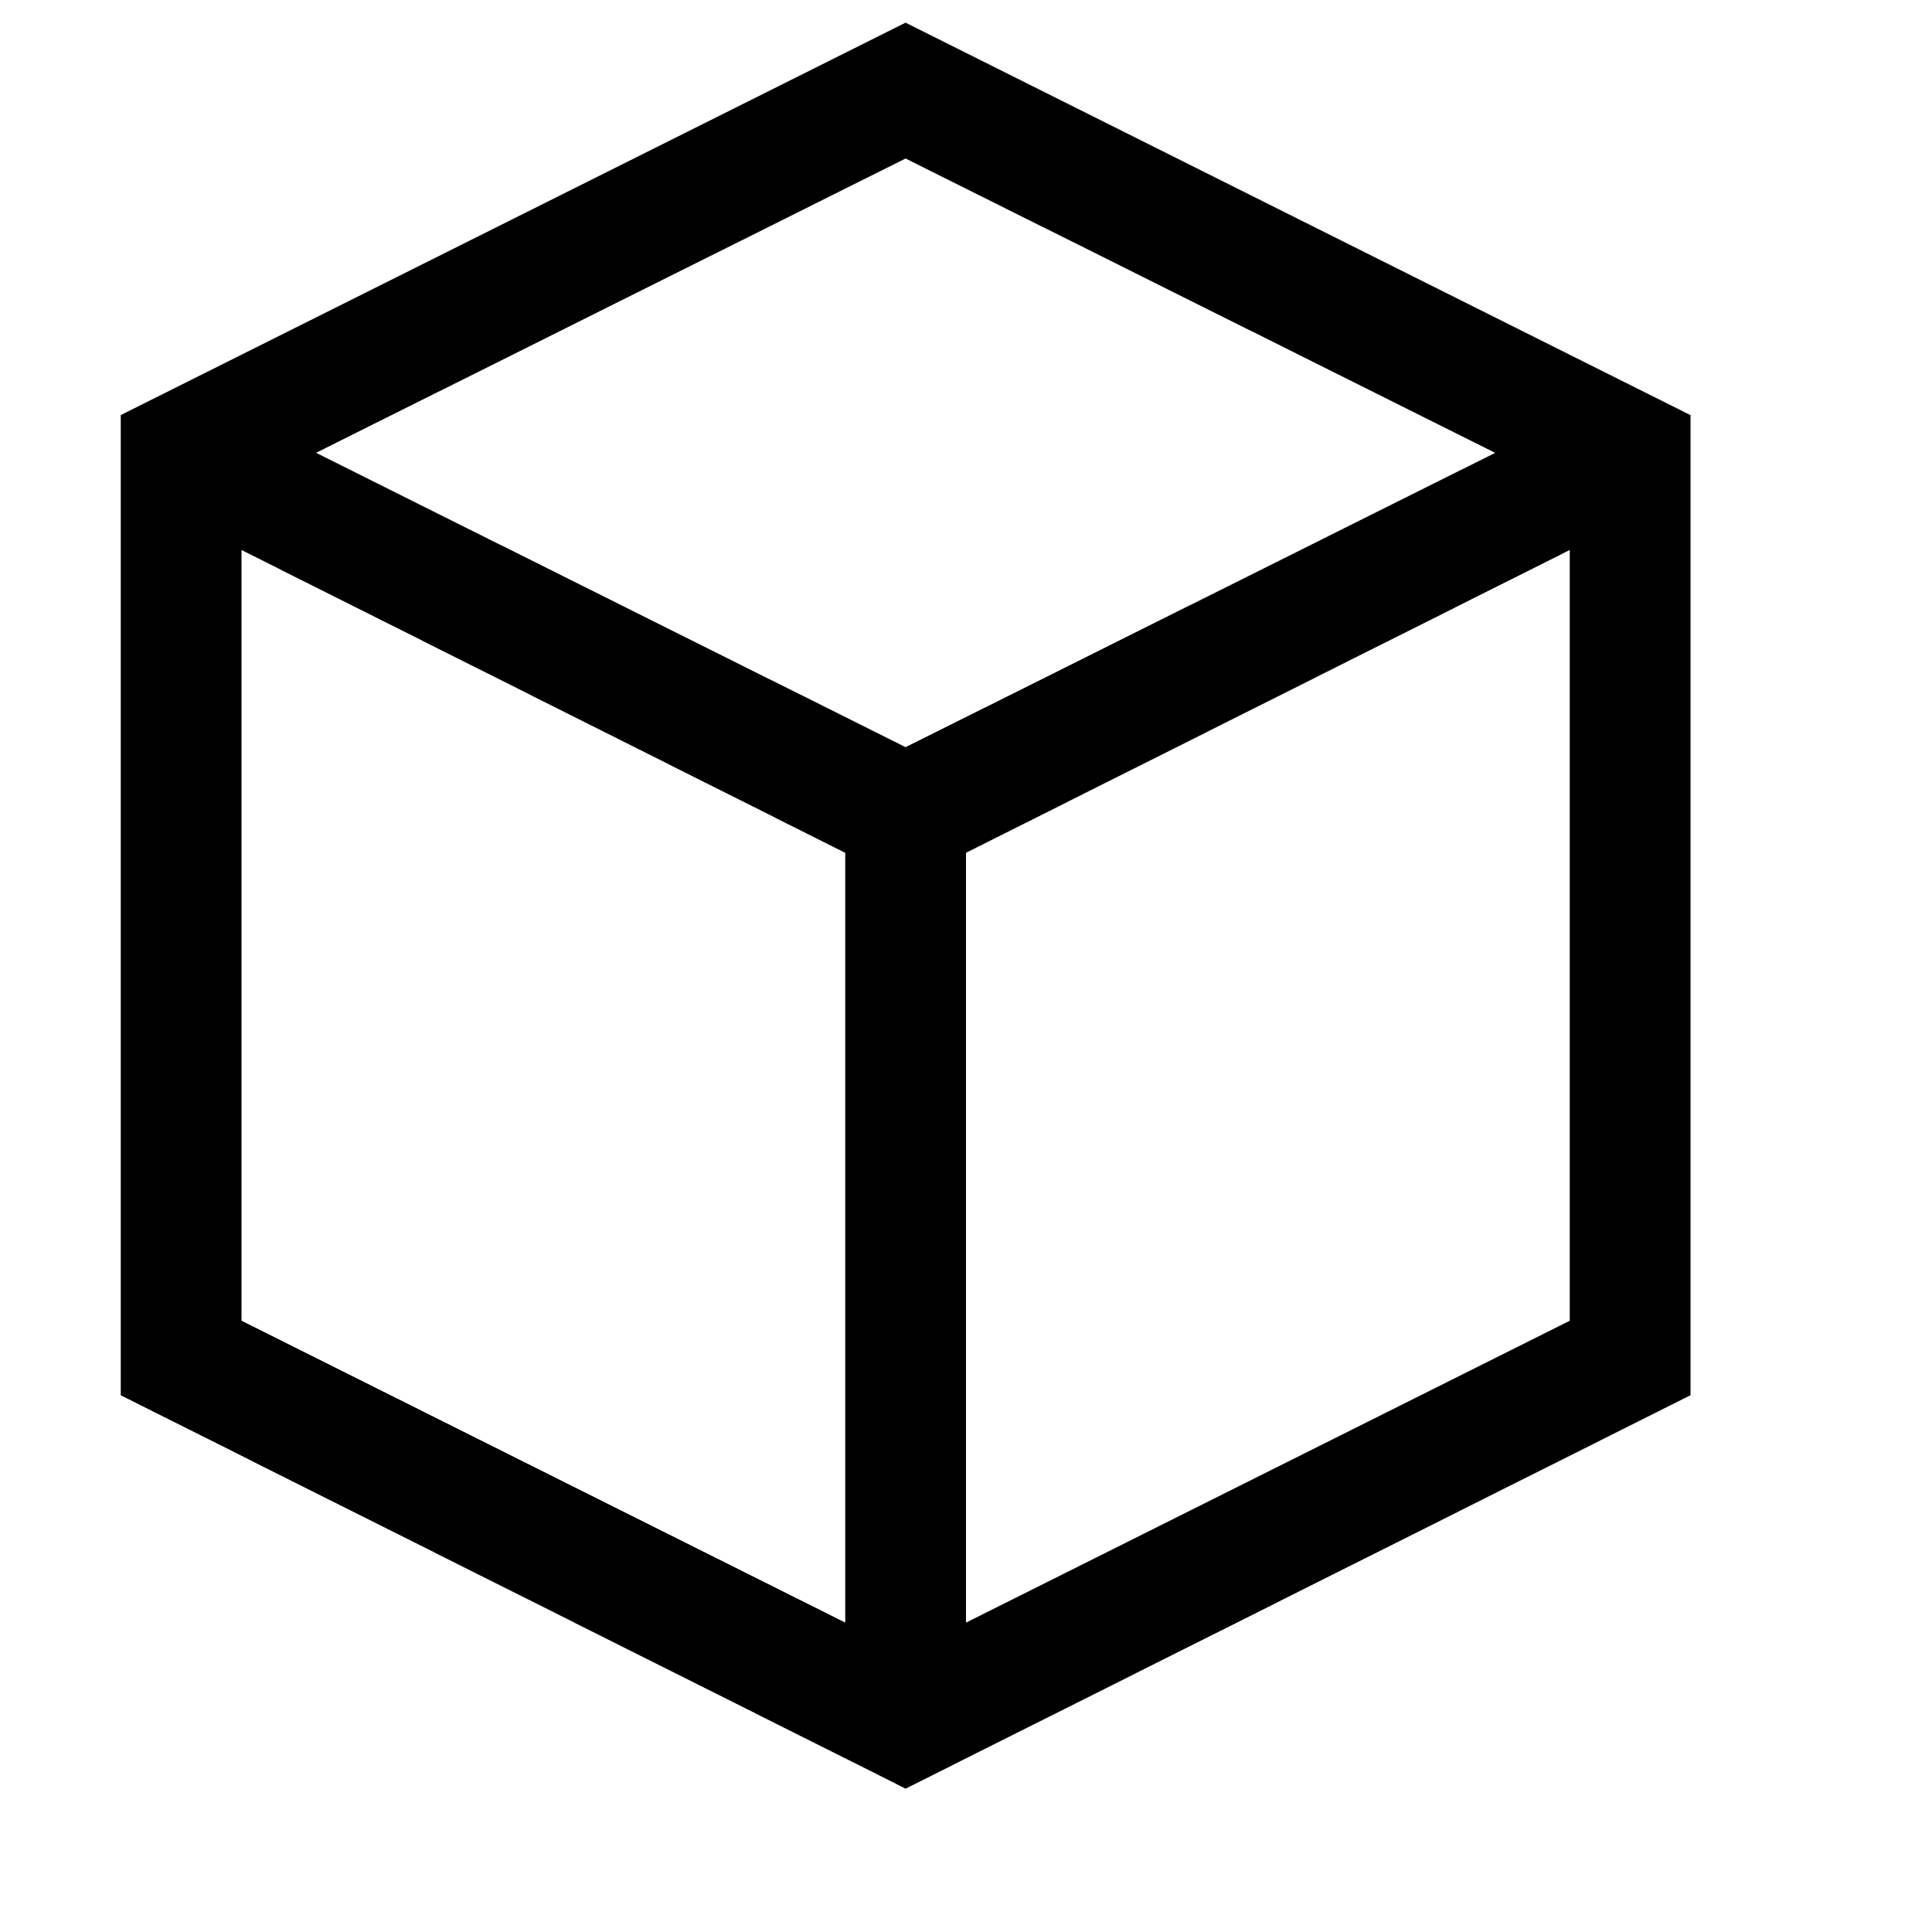
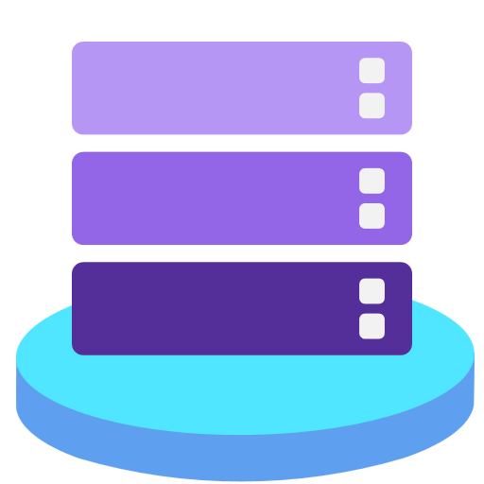



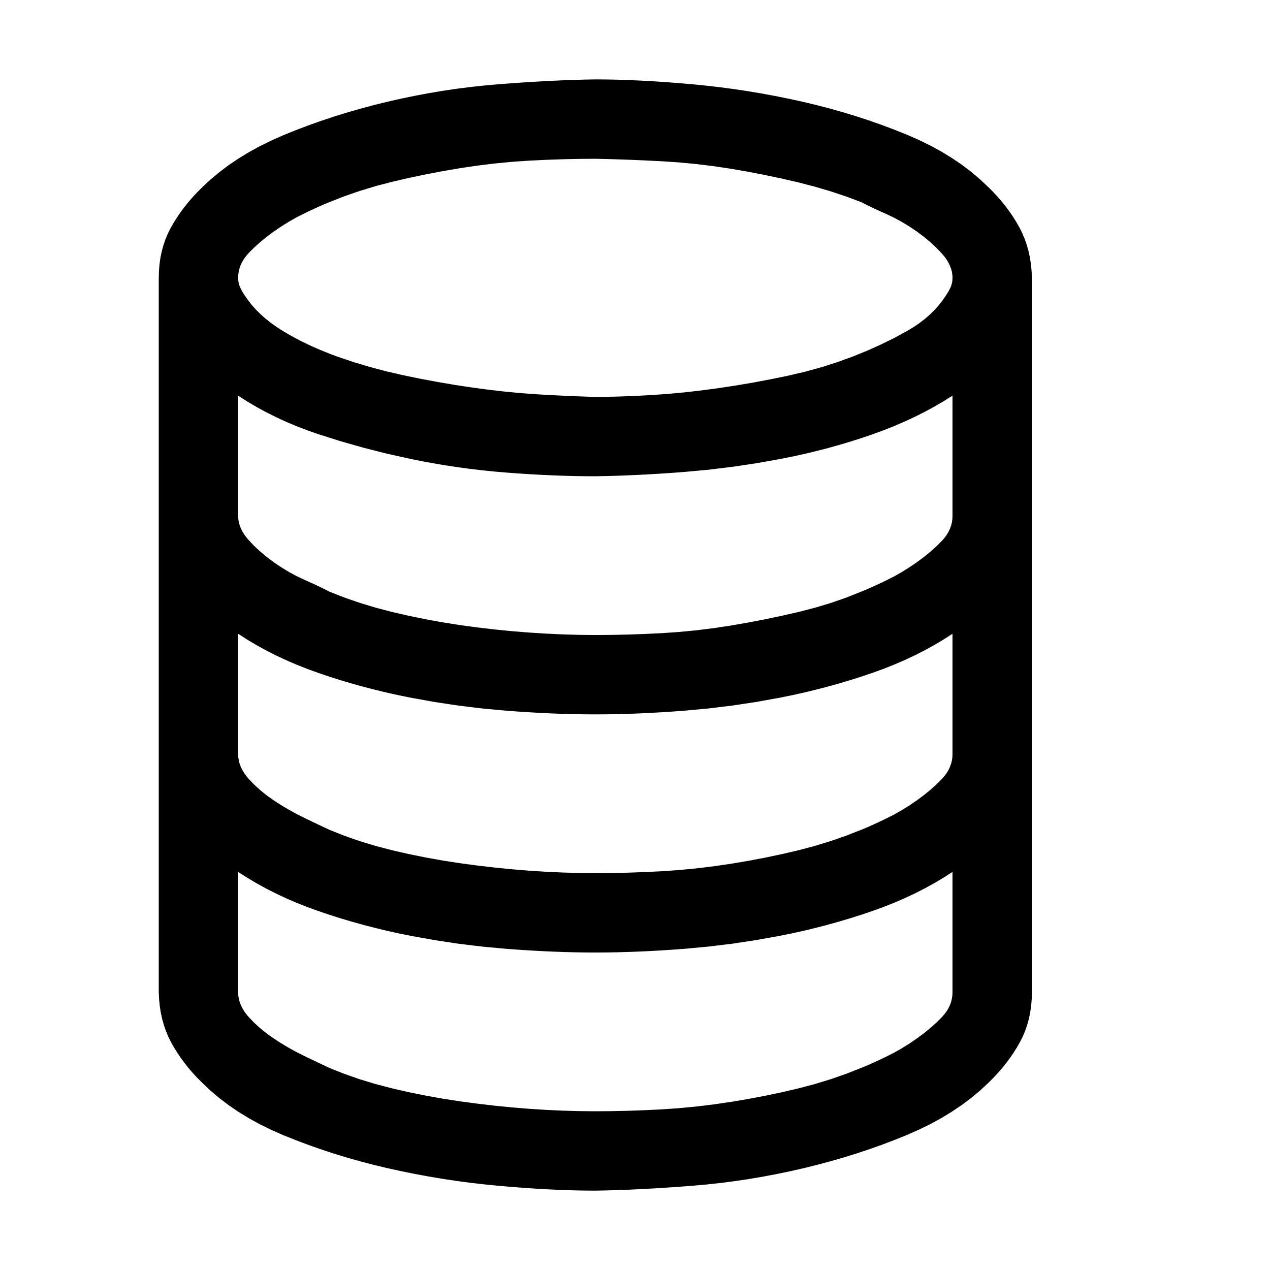



Azure Local – Solution reference architecture
Control plane Azure portal, ARM and Bicep templates, Azure CLI and tools
Microsoft
Entra ID
Azure Site Recovery
Azure Backup
Azure File Sync
Azure Update Manager
Additional Azure services integration via Azure Arc
Outbound access
to required URL endpoints
Azure Policy
Azure Monitor
Azure Key Vault
Microsoft Defender for Cloud
Traditional, non-containerized applications
Kubernetes-based
applications
Arc-enabled services
Arc VMs
Azure Virtual Desktop (session hosts)
Azure Kubernetes Service (AKS) enabled by Arc
Corp firewall
Azure Local
instance
Azure Local version releases
Hyper-V
Azure Arc
Resource Bridge
Storage Spaces Direct (S2D)
ToR Switch 1
East / West traffic
Switch / Router / Firewall
East / West traffic
ToR Switch 2
Validated Hardware
Scale: 1 to 16 machines
Azure Local machine 1
Azure Local machine 2
Azure Local machine 3
Azure Local machine 4
Azure Local machine 5
Azure Local machine 6
Solution categories
Premier Solutions for Azure Local
Integrated Systems for Azure Local
Validated Nodes for Azure Local

Slide 4

Azure Local – Cloud-based deployment architecture
Control plane Azure portal, ARM and Bicep templates, Azure CLI and tools
2
User sends cluster creation request to resource provider
Azure
Azure Resource Manager (ARM)
Azure Local resource provider
Arc-enabled servers resource providers
3
Arc extensions collect and send logs to Azure for remote troubleshooting with Microsoft support
Azure Local instance
DME sends server inventory to RP
Resource provider for Azure Local sends deployment information to Arc Lifecycle Manager extension
RP sends deployment information to Azure Edge Lifecycle Manager extension
6
1
4
Lifecycle Manager orchestration
Arc Device management extension (DME)
Arc Lifecycle Manager extension
Lifecycle Manager
Arc server agent
Network
4
Arc Resource Bridge (ARB)
Orchestrator
Update service
Arc extensions
5
Remote Support extension
Storage
Lifecycle Manager deploys Azure Resource Bridge which enables Arc VMs & AKS
Download Service
Arc Virtual machines (Arc VM)
Azure Kubernetes Service (AKS)
Health Service
Diagnostic and Telemetry extension
Machine Operating System

Slide 5

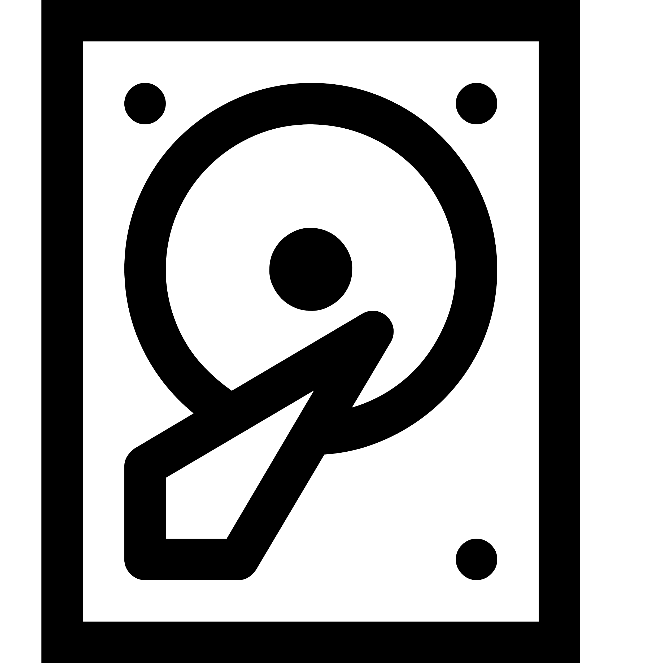

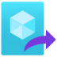




Azure Local – Arc virtual machine architecture
Arc extensions for Azure services (i.e. Azure Monitor, Azure Policy, Microsoft Defender, etc.) available for VM compliance, governance, and security
Azure Local Cloud Deployment
5
Azure services
VM Image Gallery
Azure Local instance
MOC agents and Arc Resource Bridge installed during cloud deployment, a Custom Location resource is created in Azure that points to the specific Azure Local instance.
Virtual machines as Arc VMs
User creates VM using VM image, network, and storage, using Custom Location as deployment target. VMs are configured automatically with Arc agent
User downloads image from Azure Marketplace on to Azure Local instance
3
1
4
Arc Resource Bridge (ARB)
User creates logical networks and storage paths to store VM images
Cluster Shared Volume (CSV)
Network
2
Storage path
OS image
Virtual network
Custom Location
vNIC
MOC Agent Clustered Service
Machine Operating System
Machine Operating System
Machine Operating System
MOC agent
MOC agent
MOC agent
Azure Local machine
Azure Local machine
Azure Local machine

Slide 6










Azure Local – Monitoring flow architecture
User’s metrics consumptions channels
Azure Workbooks visualization
Standard metrics
Metrics Explorer
Dashboards
Azure workbooks
Notification channels
Microsoft Customer Service and Support (CSS)
Azure Monitor
Azure Log Analytics workspace
Alert rules
Telemetry,
Diagnostics, Metrics
Metric Types and Metric Aggregations
Kusto query
Resource/Scope
Actions Groups
Signal
Data Collection Rules (DCRs)
Events and performance counters
Conditions
Telemetry,
Diagnostics, Metrics
Azure Local instance
Telemetry and Diagnostics extensions
Azure Monitor Windows Agent extension
Telemetry and Diagnostics extension
Azure Monitor Windows Agent extension
Telemetry and Diagnostics extension
Azure Monitor Windows Agent extension
Alerts extension
Alerts extension
Alerts extension
Machine Operating System
Machine Operating System
Machine Operating System
Azure Local machine
Azure Local machine
Azure Local machine

Slide 7
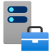





Azure Local – Storage architecture
Cloud Deployment automatically configures storage volumes with recommended resiliency
Cluster-shared volumes can be managed via Portal, WAC and PowerShell
Cloud Deployment
Windows Admin Center (WAC)
PowerShell
Azure Local instance
Arc VMs
Live Migration across Azure Local machines
Instance-wide storage pool
VMs can read/write to a VHD/X file on any cluster-shared volume (CSV)
Storage Spaces Virtual Disk
Storage Spaces Virtual Disk
Storage Spaces Virtual Disk
UserStorage_1 (CSV)
UserStorage_2 (CSV)
UserStorage_3 (CSV)
Resilient File System (ReFS)
Resilient File System (ReFS)
Resilient File System (ReFS)
VHD / VHDX
VHD / VHDX
VHD / VHDX
S2D writes multiple copies to persistent cache, using the physical flash drives in the instance machines
Machine Operating System
Machine Operating System
Machine Operating System
In-memory read cache
In-memory read cache
In-memory read cache
Azure Local machine
Azure Local machine
Azure Local machine
Software-defined storage with mirrored resiliency provide by Software Bus Layer (SBL)
Storage pool of local drives with Storage Spaces Direct (S2D)
Capacity-tier
Cache-tier
Capacity-tier
Cache-tier
Capacity-tier
Cache-tier
SSD
SSD
SSD
SSD
NVMe
NVMe
SSD
SSD
SSD
SSD
NVMe
NVMe
SSD
SSD
SSD
SSD
NVMe
NVMe

Slide 8



Azure Local – Storage Switched 2+ machines, Dual TOR, dedicated Storage, converged Management + Compute, logical connectivity
(simplified architecture)
Switch / Router / Firewall
Link Aggregation
Management, Compute, and Storage TOR 1 Network switch
Management, Compute, and Storage TOR 2 Network switch
Management, Compute, and Storage VLANs
Network ATC: Management and Compute Intent
Azure Local instance
10GB+
Ethernet Port
Management vNIC
10GB+
Ethernet Port
10GB+
Ethernet Port
Management vNIC
10GB+
Ethernet Port
Management + Compute NICs Switch Embedded Team (SET) and Virtual Filtering Platform (VFP)
Management + Compute NICs Switch Embedded Team (SET) and Virtual Filtering Platform (VFP)
Azure Local machine 1
Azure Local machine n
Scale: 2 to 16 machines
RDMA NICs | Storage Intent
RDMA NICs | Storage Intent
10GB+
Ethernet Port
SMB1
10GB+
Ethernet Port
SMB2
10GB+
Ethernet Port
SMB1
10GB+
Ethernet Port
SMB2
Network ATC: Storage Intent

Slide 9

Azure Local – Storage Switched 2+ machines, Dual TOR, dedicated Storage, converged Management + Compute, physical connectivity
(simplified architecture)
Switch / Router / Firewall
Link Aggregation
Management, Compute, and Storage TOR 1 Network switch
Management, Compute, and Storage TOR 2 Network switch
Azure Local instance
10GB+
Ethernet Port
10GB+
Ethernet Port
10GB+
Ethernet Port
SMB1
10GB+
Ethernet Port
SMB2
10GB+
Ethernet Port
10GB+
Ethernet Port
10GB+
Ethernet Port
SMB1
10GB+
Ethernet Port
SMB2
Management + Compute NICs Switch Embedded Team (SET)
RDMA NICs
Management + Compute NICs Switch Embedded Team (SET)
RDMA NICs
Azure Local machine 1
Azure Local machine n
Scale: 2 to 16 machines

Slide 10

Azure Local – Three-machines storage switchless, dual link, dual TOR network architecture, logical connectivity
(simplified architecture)
Switch / Router / Firewall
Network switch
Network switch
Trunk Port
Management and Compute networks
Trunk Port
1GB+
Ethernet Port
1GB+
Ethernet Port
1GB+
Ethernet Port
1GB+
Ethernet Port
1GB+
Ethernet Port
1GB+
Ethernet Port
Azure Local instance
Management + Compute Intent
Management + Compute Intent
Management + Compute Intent
Azure Local machine 1
Azure Local machine 2
Azure Local machine 3
RDMA NICs | Storage Intent
RDMA NICs | Storage Intent
RDMA NICs | Storage Intent
10GB+
Ethernet Port
IP: 10.0.1.1
10GB+
Ethernet Port
IP: 10.0.2.1
10GB+
Ethernet Port
IP: 10.0.3.1
10GB+
Ethernet Port
IP: 10.0.4.1
10GB+
Ethernet Port
IP: 10.0.1.2
10GB+
Ethernet Port
IP: 10.0.2.2
10GB+
Ethernet Port
IP: 10.0.5.2
10GB+
Ethernet Port
IP: 10.0.6.2
10GB+
Ethernet Port
IP: 10.0.3.3
10GB+
Ethernet Port
IP: 10.0.4.3
10GB+
Ethernet Port
IP: 10.0.5.3
10GB+
Ethernet Port
IP: 10.0.6.3
Subnet 1: 10.0.1.x/24
Subnet 3: 10.0.5.x/24
Subnet 2: 10.0.2.x/24
Subnet 6: 10.0.6.x/24
Subnet 5: 10.0.3.x/24
Subnet 4: 10.0.4.x/24
Storage Network ATC intent: VLAN 711, AutoIP=False

Slide 11
Azure Local – Three-machines storage switchless, dual link, dual TOR network architecture, physical connectivity
(simplified architecture)
Switch / Router / Firewall
Network switch
Link Aggregation
Network switch
1GB+
Ethernet Port
1GB+
Ethernet Port
1GB+
Ethernet Port
1GB+
Ethernet Port
1GB+
Ethernet Port
1GB+
Ethernet Port
Azure Local instance
Management + Compute NICs Switch Embedded Team (SET)
Management + Compute NICs Switch Embedded Team (SET)
Management + Compute NICs Switch Embedded Team (SET)
Azure Local machine 1
Azure Local machine 2
Azure Local machine 3
RDMA NICs
RDMA NICs
RDMA NICs
10GB+
Ethernet Port
SMB1
10GB+
Ethernet Port
SMB2
10GB+
Ethernet Port
SMB3
10GB+
Ethernet Port
SMB4
10GB+
Ethernet Port
SMB1
10GB+
Ethernet Port
SMB2
10GB+
Ethernet Port
SMB3
10GB+
Ethernet Port
SMB4
10GB+
Ethernet Port
SMB1
10GB+
Ethernet Port
SMB2
10GB+
Ethernet Port
SMB3
10GB+
Ethernet Port
SMB4

Slide 12
Azure Local – Fully converged network architecture
Azure Local instance networks key
Network interface requirements
All traffic types (management, compute and storage) share the same physical network adapter ports in a fully converged host networking pattern
One port per machine connected to each switch, all ports configured as Trunk ports, (two links per machine)
Management VLAN
Compute VLAN(s)
Multiple Compute Logical Networks and VLAN(s) can be configured for VM, AKS Cluster or AVD workloads
Storage Network 1 VLAN
Storage Network 2 VLAN
Minimum 10GB speed required for interfaces when using the fully converged network topology
Remote direct memory access (RDMA) capable NICs required
25GB+ recommended for increased performance and scalability
Switch / Router / Firewall
Network switch
Network switch
Trunk Port
Azure Local instance networks
Trunk Port
Network ATC: Management, Compute and Storage Intent
Azure Local instance
10GB+
Ethernet Port
10GB+
Ethernet Port
10GB+
Ethernet Port
10GB+
Ethernet Port
10GB+
Ethernet Port
10GB+
Ethernet Port
Azure Local machine 1
Azure Local machine 2
Azure Local machine 3
Management + Compute + Storage Intent
Management + Compute + Storage Intent
Management + Compute + Storage Intent

Slide 13
Azure Local – Three-machines switchless dual link, dual TOR network architecture
Azure Local instance networks key
Network interface requirements
Management and Compute Intent converged using a switch embedded team (SET) of 2 NICs and Trunk port configuration
Multiple Compute logical networks with different VLAN IDs can be configured for VM, AKS Cluster or AVD workloads
Single VLAN for the Management network
Storage Intent uses 6 x separate layer 2 networks, with no default gateway configured on the ethernet interface settings
Switch / Router / Firewall
Management and Compute Intent requires minimum 2 x 1GB+ ports, with one connected to each switch
Converged using a switch embedded team (SET) to provide resiliency and traffic load balancing
Network switch
Network switch
Network interface requirements
Storage traffic has two (dual) links for redundancy
Dedicated 4 x 10GB (or higher) remote direct memory access (RDMA) capable ports
Trunk Port
Management and Compute networks
Trunk Port
1GB+
Ethernet Port
1GB+
Ethernet Port
1GB+
Ethernet Port
1GB+
Ethernet Port
1GB+
Ethernet Port
1GB+
Ethernet Port
Azure Local instance
Management + Compute Intent
Management + Compute Intent
Management + Compute Intent
Azure Local machine 1
Azure Local machine 2
Azure Local machine 3
RDMA NICs | Storage Intent
RDMA NICs | Storage Intent
RDMA NICs | Storage Intent
10GB+
Ethernet Port
IP: 10.0.1.1
10GB+
Ethernet Port
IP: 10.0.2.1
10GB+
Ethernet Port
IP: 10.0.3.1
10GB+
Ethernet Port
IP: 10.0.4.1
10GB+
Ethernet Port
IP: 10.0.1.2
10GB+
Ethernet Port
IP: 10.0.2.2
10GB+
Ethernet Port
IP: 10.0.5.2
10GB+
Ethernet Port
IP: 10.0.6.2
10GB+
Ethernet Port
IP: 10.0.3.3
10GB+
Ethernet Port
IP: 10.0.4.3
10GB+
Ethernet Port
IP: 10.0.5.3
10GB+
Ethernet Port
IP: 10.0.6.3
Subnet 1: 10.0.1.x/24
Subnet 3: 10.0.5.x/24
Subnet 2: 10.0.2.x/24
Subnet 6: 10.0.6.x/24
Subnet 5: 10.0.3.x/24
Subnet 4: 10.0.4.x/24
Storage Network ATC intent: VLAN 711, AutoIP=False

Slide 14
Azure Local – Two-machines switchless dual link network architecture
Network interface requirements
Azure Local instance networks key
Management and Compute Intents requires minimum 2 x 1GB+ NICs, with one connected to each switch
Converged using a switch embedded team (SET) to provide resiliency and traffic load balancing
Management and Compute Intents converged using a switch embedded team (SET) of 2 NICs and Trunk port configuration
Multiple Compute Logical Networks and VLAN(s) can be configured for VM, AKS Cluster or AVD workloads
Single VLAN for Management network
Storage Intents use 2 x separate non-routable (layer 2) networks, with no default gateway configured on the ethernet interfaces
Switch / Router / Firewall
Network switch
Network switch
Network interface requirements
Storage Intent has dual links for redundancy
Dedicated 2 x 10GB (or higher) remote direct memory access (RDMA) capable NICs per machine
Trunk Port
Network ATC: Management and Compute
Trunk Port
1GB+
Ethernet Port
1GB+
Ethernet Port
1GB+
Ethernet Port
1GB+
Ethernet Port
Azure Local instance
Azure Local machine 1
Azure Local machine 2
Management + Compute Intent
Management + Compute Intent
RDMA NICs | Storage Intent
RDMA NICs | Storage Intent
10GB+
Ethernet Port
10GB+
Ethernet Port
10GB+
Ethernet Port
10GB+
Ethernet Port
Direct peer-to-peer connections for storage replication traffic
Storage Network 1
Storage Network 2
Network ATC: Storage Intent

Slide 15
Azure Local – Four-node storage switchless, dual link logical connectivity (simplified architecture)
Switch / Router / Firewall
Network switch
Network switch
Trunk Port
Trunk Port
Management and Compute networks
1GB+
Ethernet Port
1GB+
Ethernet Port
1GB+
Ethernet Port
1GB+
Ethernet Port
1GB+
Ethernet Port
1GB+
Ethernet Port
1GB+
Ethernet Port
1GB+
Ethernet Port
Azure Local machine 1
Azure Local machine 2
Azure Local machine 3
Azure Local machine 4
Management + Compute Intent
Management + Compute Intent
Management + Compute Intent
Management + Compute Intent
Storage Network ATC intent: VLAN 711, AutoIP=False
RDMA NICs | Storage Intent
RDMA NICs | Storage Intent
RDMA NICs | Storage Intent
RDMA NICs | Storage Intent
10GB+
Ethernet
Port
IP: 10.0.1.2
10GB+
Ethernet
Port
IP: 10.0.2.2
10GB+
Ethernet
Port
IP: 10.0.3.2
10GB+
Ethernet
Port
IP: 10.0.4.2
10GB+
Ethernet
Port
IP: 10.0.5.2
10GB+
Ethernet
Port
IP: 10.0.6.2
10GB+
Ethernet
Port
IP: 10.0.1.3
10GB+
Ethernet
Port
IP: 10.0.2.3
10GB+
Ethernet
Port
IP: 10.0.7.2
10GB+
Ethernet
Port
IP: 10.0.8.2
10GB+
Ethernet
Port
IP: 10.0.9.2
10GB+
Ethernet
Port
IP: 10.0.10.2
10GB+
Ethernet
Port
IP: 10.0.7.3
10GB+
Ethernet
Port
IP: 10.0.8.3
10GB+
Ethernet
Port
IP: 10.0.3.3
10GB+
Ethernet
Port
IP: 10.0.4.3
10GB+
Ethernet
Port
IP: 10.0.11.2
10GB+
Ethernet
Port
IP: 10.0.12.2
10GB+
Ethernet
Port
IP: 10.0.9.3
10GB+
Ethernet
Port
IP: 10.0.10.3
10GB+
Ethernet
Port
IP: 10.0.11.3
10GB+
Ethernet
Port
IP: 10.0.12.3
10GB+
Ethernet
Port
IP: 10.0.5.3
10GB+
Ethernet
Port
IP: 10.0.6.3
Subnet 1: 10.0.1.x/24
Subnet 2: 10.0.2.x/24
Subnet 3: 10.0.3.x/24
Subnet 4: 10.0.4.x/24
Subnet 10: 10.0.10.x/24
Subnet 5: 10.0.5.x/24
Subnet 9: 10.0.9.x/24
Azure Local instance
Subnet 6: 10.0.6.x/24
Subnet 7: 10.0.7.x/24
Subnet 8: 10.0.8.x/24
Subnet 11: 10.0.11.x/24
Subnet 12: 10.0.12.x/24

Slide 16

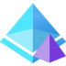




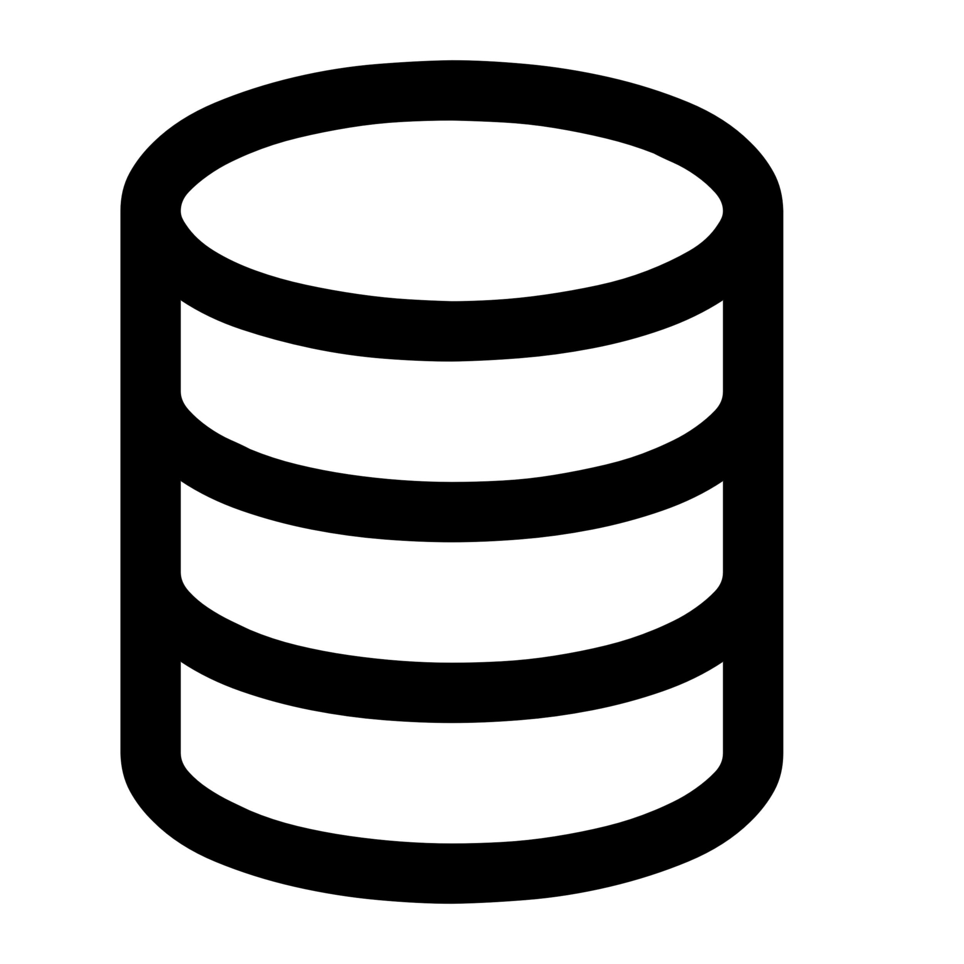


Azure Local – Azure Virtual Desktop reference architecture
Control plane Azure portal, ARM and Bicep templates, Azure CLI and tools
Microsoft
Entra ID
User authentication and token exchange during login
Azure Virtual Desktop
Azure Site Recovery
Azure Backup
Azure File Sync
Azure Update Manager
Additional Azure services integration via Azure Arc
2
Azure Policy
Azure Monitor
Azure Key Vault
Microsoft Defender for Cloud
Hybrid identity synchronization between on-premises AD DS and cloud-based Entra ID for local authentication and cloud access
Session initiation to Azure Virtual Desktop in Azure from user’s device
3
User devices
4
1
Azure Virtual Desktop client
Azure Virtual Desktop agent connects to Azure, handling session brokering, user sessions, metering, and diagnostics
Active Directory Domain Services
Arc agent integration for additional governance, monitoring, and lifecycle management
RDP Shortpath (with VPN) or Direct UDP connection
User credential validation, group policy application
Arc VMs
Azure Virtual Desktop (session hosts)
User profile storage location:
Dedicated NAS / SMB file share storage (Preferred option) OR
S2D pool on Azure Local instance
Azure Virtual Desktop agent
Azure Arc agent
Azure Local instance
5
Network attached storage OR SMB File Share
Azure Local version releases
User profiles
Hyper-V
Azure Arc
Resource Bridge
Storage Spaces Direct (S2D)
User profiles

Slide 17


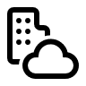

Azure Migrate for Azure Local – Solution architecture (Public Preview)
Storage Accounts
Azure Migrate
Azure Resource Manager
Azure Migrate Project
Azure Local Resource Provider
Azure Key Vault
SSL/443
SSL/443
On-premises
Control plane (VMware vCenter or Hyper-V server)
Azure Local instance
Azure Migrate target appliance
Arc resource bridge (ARB)
Arc VMs
VMware vSphere or Hyper-V source cluster
Infrastructure
Virtual Machine Templates
Virtual Machines
Azure Migrate source appliance
Storage
Hyper-V Failover Cluster Manager
Virtual Networks
VM
VM
VM
Logical Networks (LNET)

Slide 18



Azure Migrate for Azure Local – Setup and Discovery (Public Preview)
Azure Migrate
2
A new Azure Migrate project is created and generated with both source and target keys
New Project
Source appliance discovers VMs in source cluster, creates an inventory, and sends the list to the Azure Migrate project where the user can select which of the VMs to migrate
4
Source key
Target key
A virtual machine in source environment is provisioned and installed with Azure Migrate appliance, followed by appliance linkage to Azure Migrate project with source key
A virtual machine is provisioned in target environment, and installed with Azure Migrate appliance followed by appliance linkage to Azure Migrate project with target key
3
5
On-premises
Windows Server virtual machines
Azure Migrate source appliance (Windows Server 2022)
Azure Migrate target appliance (Windows Server 2022)
Windows Client virtual machines
Arc resource bridge (ARB)
User configures a storage path and LNET that the migrated VMs will use
1
Linux virtual machines
1
Cluster Shared Volume (CSV)
Logical Networks
(LNET)
Storage Path
VMware vSphere or Hyper-V source cluster
Azure Local instance

Slide 19
Azure Migrate for Azure Local – Replication (Public Preview)
Azure Migrate
New Project
User selects virtual machines for initial replication and configures target settings for the virtual machines, including compute, disk resizing, LNET, and storage path, then initiates replication process
1
On-premises
Windows Server virtual machines
Azure Migrate source appliance (Windows Server 2022)
Azure Migrate target appliance (Windows Server 2022)
Windows Client virtual machines
Arc resource bridge (ARB)
2
Initial replication is initiated to copy all disks and transfer logs from source to target cluster
Cluster Shared Volume (CSV)
Logical Networks (LNET)
Linux virtual machines
Storage Path
Initial replication
VMware vSphere or Hyper-V source cluster
Azure Local instance
Delta replication (hourly)
3
Delta replication copies any new changes during or after initial replication

Slide 20


Azure Migrate for Azure Local – Migration (Public Preview)
Azure Migrate
1
Once replication is complete, user initiate a migration from Azure Migrate in the Azure portal
New Project
ITOps
On-premises
Linux virtual machines
Windows Client virtual machines
3
User turns off source virtual machine after final delta replication
Windows Server virtual machines
Windows Server virtual machines
Azure Migrate source appliance (Windows Server 2022)
Azure Migrate target appliance (Windows Server 2022)
Arc resource bridge (ARB)
4
Windows Client virtual machines
ARB starts migrated virtual machine on target cluster
Cluster Shared Volume (CSV)
Logical Networks (LNET)
Linux virtual machines
Storage Path
VMware vSphere or Hyper-V source cluster
Delta replication (hourly)
Azure Local instance
2
Once migration starts, one final delta replication is completed

Slide 21

Azure Migrate for Azure Local – Decommission (Public Preview)
Azure Migrate
New Project
ITOps
On-premises
Linux virtual machines
1
2
Upon completion, user deletes both source and target Azure Migrate appliance
2
Windows Client virtual machines
User completes migration and decommission source virtual machines
Windows Server virtual machines
Windows Server virtual machines
Azure Migrate source appliance (Windows Server 2022)
Azure Migrate target appliance (Windows Server 2022)
Windows Client virtual machines
Arc resource bridge (ARB)
Cluster Shared Volume (CSV)
Logical Networks (LNET)
Linux virtual machines
Storage Path
VMware vSphere or Hyper-V source cluster
Azure Local instance

Slide 22

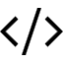



Azure Container Storage enabled by Azure Arc (ACSA) – Solution Architecture
Edge
Cloud
Power BI
Edge located Arc-enabled Kubernetes
Kubernetes-based application
Data visualization
Azure storage services
Generated application data
File data flow
Azure Block Blob storage account
Azure Container Storage enabled by Azure Arc (ACSA)
ACSA writes out using Blob storage SDK for copying file-based data to Azure storage services
Azure Data Lake Storage (ADLS) Gen2
Local storage
Cloud Ingest
File-based data to blob conversion
Azure OneLake

Slide 23
Azure Container Storage enabled by Azure Arc (ACSA) – Edge Volumes Solution Architecture
Local Shared Edge Volumes
Storage local to your cluster
Cloud connection independent
Cloud Ingest Edge Volumes
Disconnection tolerant data ingest
Purge from edge once uploaded
Configurable
Edge-located Arc-enabled Kubernetes cluster
Kubernetes-based application
App service
App service
App service
Power BI
Generated application data
Data visualization
Azure Container Storage
enabled by Azure Arc cluster
Azure storage services
File data flow
3-way replication for high-availability and fault tolerance
Cloud Volume
Azure Block Blob storage account
Local Shared Volume 0
Ingest Subvolume 0
Blob SDK data flow
Local Shared Volume 1
Ingest Subvolume 1
Azure Data Lake Storage (ADLS) Gen2
Local Shared Volume n
Ingest Subvolume n
Azure OneLake
Worker node 0
Worker node 1
Worker node n
Physical disks
Physical disks
Physical disks

Slide 24
Azure Container Storage enabled by Azure Arc (ACSA) – Using Edge Volumes Together
Edge-located Arc-enabled Kubernetes cluster
Kubernetes-based application
App service
App service
App service
Generated application data
File data flow
File data flow
User or application is copying files
Power BI
Data visualization
Azure Container Storage enabled by Azure Arc (ACSA)
Azure OneLake
Local Shared Volume
Cloud Volume
Ingest Subvolume
Blob SDK data flow

